Slide 1
Lab5
Projection and hidden surface removal

Slide 2
5.1. Projection
gluPerspective(fovy, aspect, zNear, zFar);
glOrtho (left, right, bottom, top, near, far);
glFrustum(left, right, bottom, top, near, far)

Slide 3
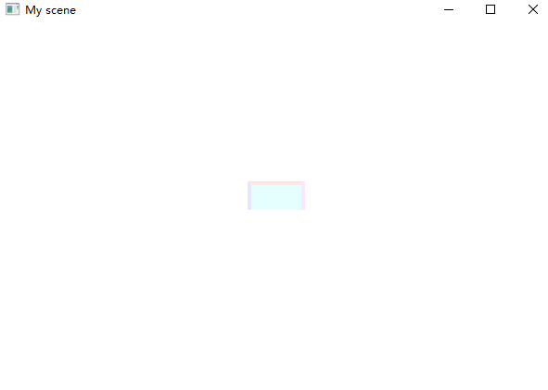
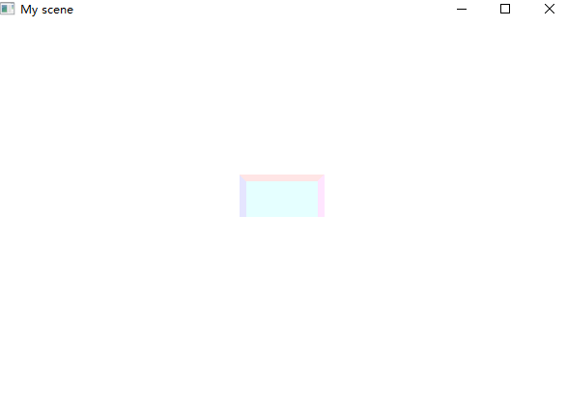
5.1. Projection
gluPerspective(fovy, aspect, zNear, zFar);
Try other values
gluPerspective(60.0, (GLdouble)width/(GLdouble)height, 1.0, 4000.0);
gluPerspective(45.0, (GLdouble)width/(GLdouble)height, 1.0, 4000.0);

Slide 4
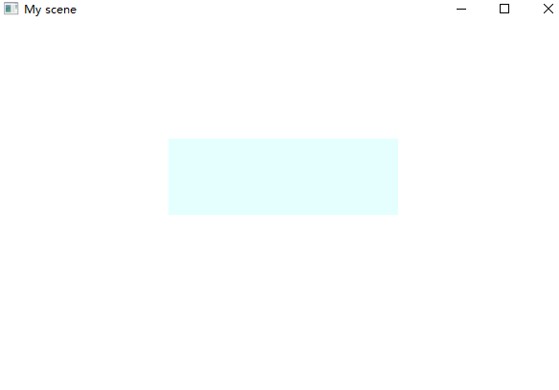
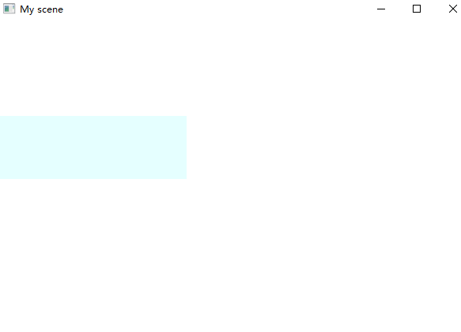
5.1. Projection
glOrtho (left, right, bottom, top, near, far);
Try other values
glOrtho(-100.f, 100.f, -100.f, 100.f, 100.f, 1000.f);
glOrtho(0.f, 100.f, -100.f, 100.f, 100.f, 1000.f);

Slide 5
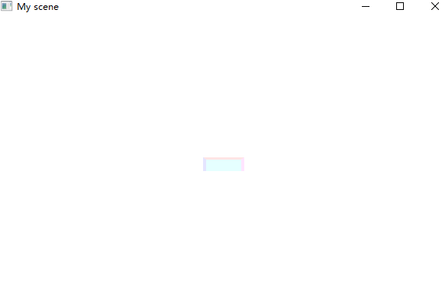
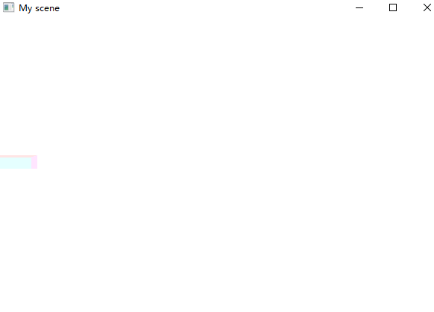
5.1. Projection
glFrustum(left, right, bottom, top, near, far)
Try other values
glFrustum(-100.f, 100.f, -100.f, 100.f, 100.f, 1000.f);
glFrustum(0.f, 100.f, -100.f, 100.f, 100.f, 1000.f);

Slide 6
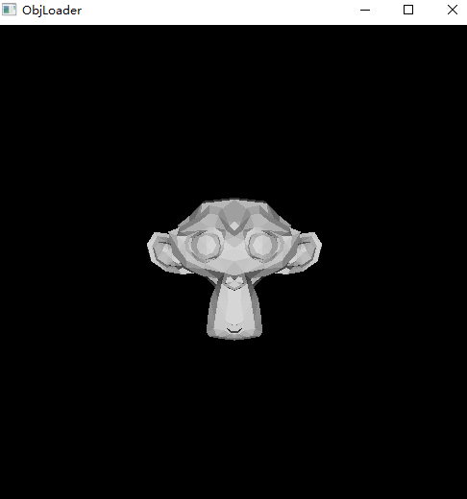
5.2. Load .obj
ObjLoader.h
ObjLoader.cpp
main.cpp
Monkey.obj

Slide 7
5.2. Load .obj files to view
Try:
cow.obj, porsche.obj, and dinosaur.obj in “data” sub-directory
The above 3 models are large large when it is loaded into the program. Please to rescale it to become smaller. And use glFrustum, gluPerspective, and glOrtho by setting different parameters in order to view them …

Slide 8
5.3. Solar System
Try:
Change parameters of Mars and Earth to see some changes in display.
Try to add other planets … Have fun !! ☺
Try to learn the object oriented style of the class structures of Planet and Planet2
In your project, we expect you would have object-oriented style like the classes Planet and Planet 2.

